Slide 1
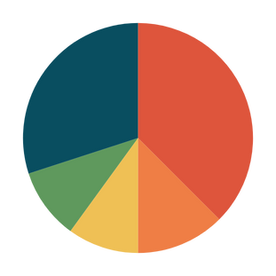
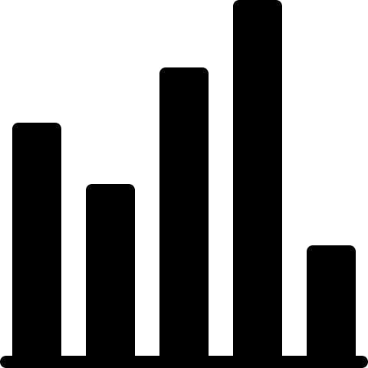
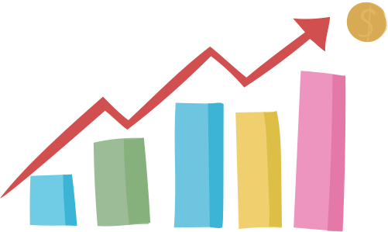
Read and Interpret
Charts & Graphs
Javeriya Ahmed Hussain

Slide 2
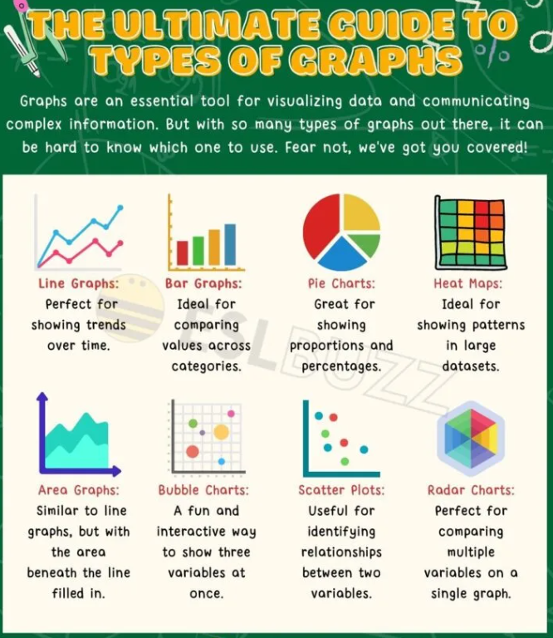

Slide 3
Graphs are visual representations of data that are used to display information in a clear and concise manner. They are an important tool for communicating complex information in an easy-to-understand format. Graphs can be used to show trends, patterns, relationships, and comparisons between different sets of data.

Slide 4

Applying Types of Graphs and Charts in English Vocabulary
Words and Phrases | Definition
Increase | To become larger or more
Decrease | To become smaller or less
Rise | To go up
Fall | To go down
Peak | The highest point
Decrease | To become smaller or less
Rise | To go up

Slide 5

Example
“The sales figures for the company increased steadily over the past year, reaching a peak in December before declining slightly in January.”

Slide 6
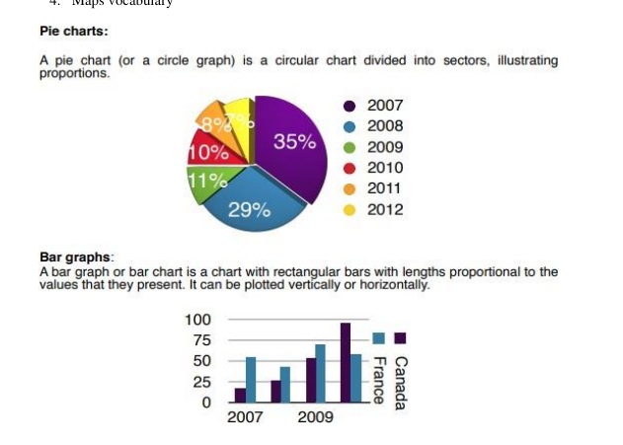

Slide 7
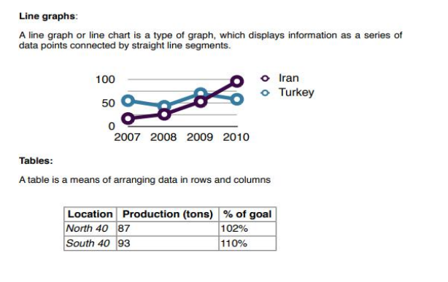

Slide 8
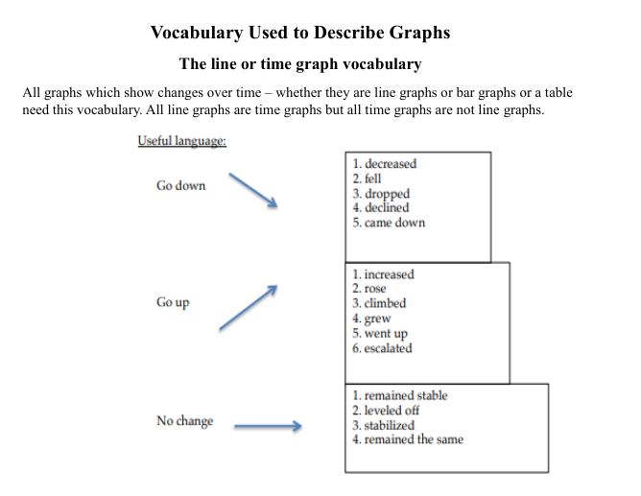

Slide 9
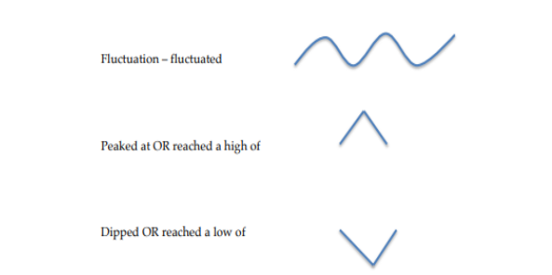
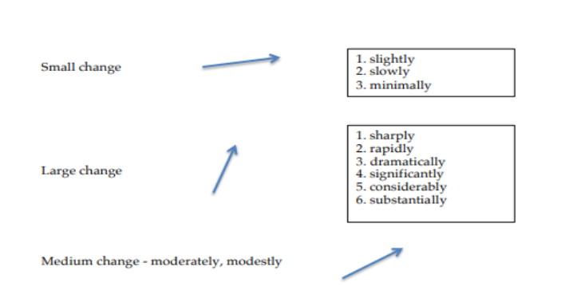

Slide 10
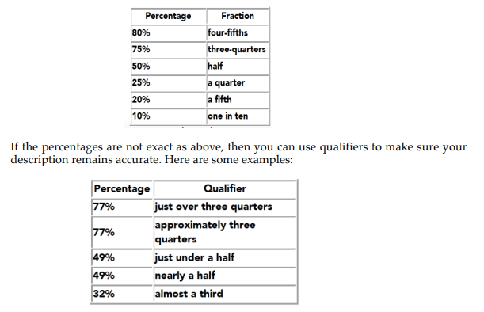
Percentage Vocabulary

Slide 11
Refer to the pg. numbers listed below for vocabulary related to graphs and charts.
List of verbs , pg. # 329
List of nouns and adjectives, pg. # 330
List of adverbs , pg. # 331

Slide 12
How to change adjective+noun structures to verb+adverbs
happy child
smile happily
quick runner
run quickly
Convert the noun and adjective into verb and adverb:
sharp increase
rapid growth
dramatic shift

Slide 13
Cont.
The number of attendees rose dramatically.
There was a dramatic rise in the number of attendees.
there is/was/has been + a/an + (adverb) + adjective + noun
there are/were/have been + (adverb) + adjective + noun
The prices fluctuated wildly during the last few months.
There were wild fluctuations during the last few months.

Slide 14
Practice
Sales increased significantly.
There were sharp drops in temperatures.

